Slide 1
“Data Analysis Project” GitHub Link for Project Files:- https://github.com/hemantg111/INI8-Labs_Assignment.git
By
Hemant Gupta LinkedIn- https://www.linkedin.com/in/hemant-gupta-4914baa6

Slide 2
Overview
To address the KPIs and fetch the important insights from the datasets.
Tool Used:- Power BI
Requirements in the report.
1. Date table.
2. Date slicer (Slider) on page. .
3. Count the number of cars of a particular brand/company/department. These should be Individual cards grouped together.
4. Calculated column on car table that shows the latest carboughdate based on Buyer details.
5. Calculate the average salary from a particular country.
6. Calculate the make year with the highest average price.
7. The most popular car brand for each gender

Slide 3
Steps Taken to Analyze the Recipe Data
Understanding the Problem:
The task involves analyzing the data based on various parameters to retrieve actionable insights from the dataset.
Data Collection:
Collected raw data in the form of a CSV and excel file.
Import the data into Power BI Desktop using the ‘Get Data' option.
Data Cleaning:
The raw data contained issues such as null values, , data type and blank data fields.
Performed data cleaning by using Power Query Editor.
Loaded the cleaned data into Power BI Desktop to create visuals based on the specified parameters.
Data Analysis:
Created visuals, including Slicers, Card Visuals, Tables to analyze the data.
Identified trends and extracted insights from the visuals data.
Interpreting Results:
Derived insights from the visuals.
Compiled a final report detailing the data analysis findings.

Slide 4
DAX Used In This Dashboard 1. AvgPriceByMakeYear = CALCULATE(AVERAGE(Cars[Price]),ALLEXCEPT(Cars, Cars[Make_Year])) 2. LatestCarBoughtDate = CALCULATE( MAX('Employee Details'[carboughtdate]),FILTER('Employee Details', 'Employee Details'[car_ID] = Cars[Car_ID])) 3. DateTable = CALENDAR(MIN('Employee Details'[joineddate]), MAX('Employee Details'[joineddate])) 4. AvgSalaryByCountry = CALCULATE(AVERAGE('Employee Details'[salary]),ALLEXCEPT('Company', 'Company'[Country])) 5. PopularCarBrand = CALCULATE(COUNTROWS(Cars),ALLEXCEPT('Employee Details', 'Employee Details'[gender]), TREATAS(VALUES('Employee Details'[car_ID]), Cars[Car_ID]))

Slide 5
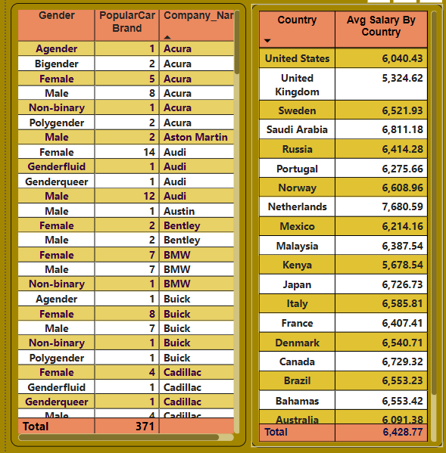
Table Chart
In this table visuals, We can analyze-
1. The most popular car brand for each gender.
2. The average salary from a particular country.

Slide 6
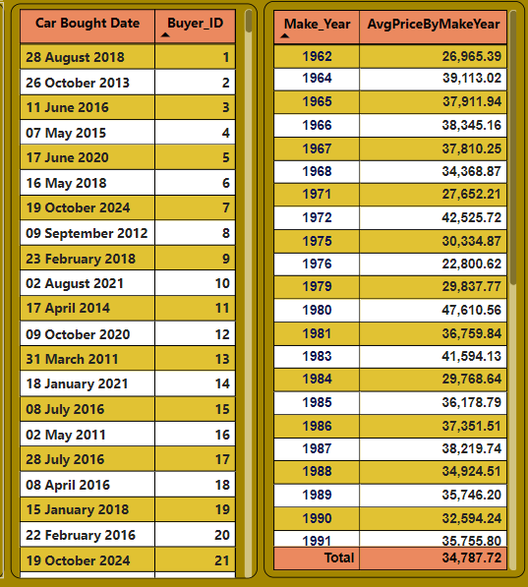
Tables
In this table visuals, We can analyze :-
The latest carboughdate based on Buyer details.
2. The make year with the highest average price.

Slide 7

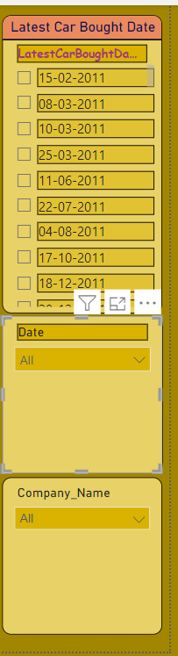
In these visuals, We can analyze :- 1. Total number of cars of a particular brand/company/department. 2. Slicers Based on ‘Latest Car Bought Date’ , Company Name and Date.

Slide 8
Thank You

